Slide 1
Simple storage service – S3

Slide 2
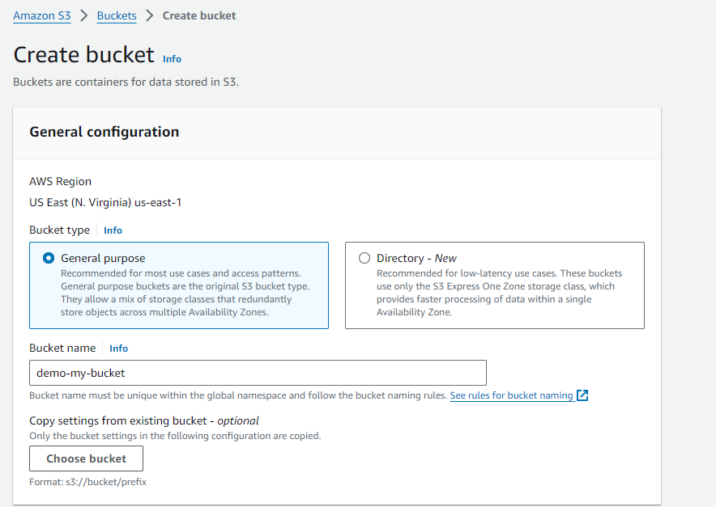
(1) Create Bucket

Slide 3
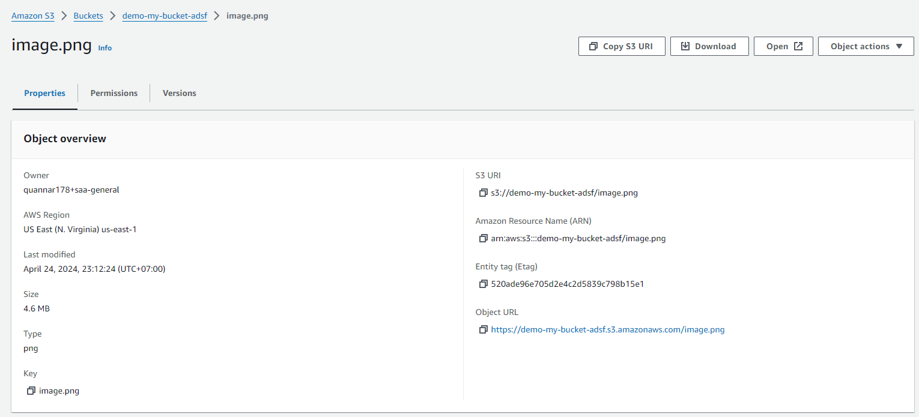
(2) Upload file to bucket

Slide 4
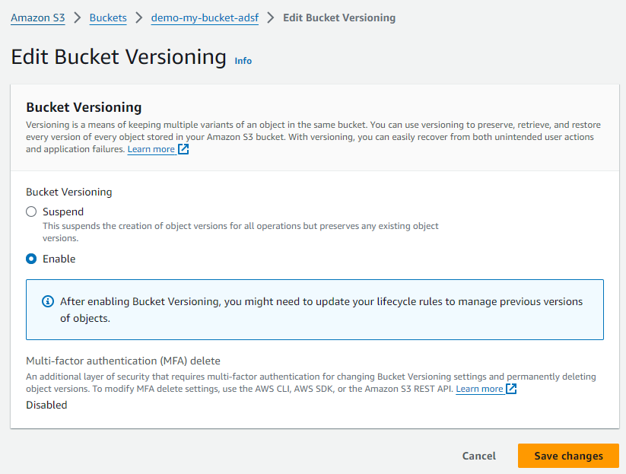
(3) Enable bucket versioning

Slide 5
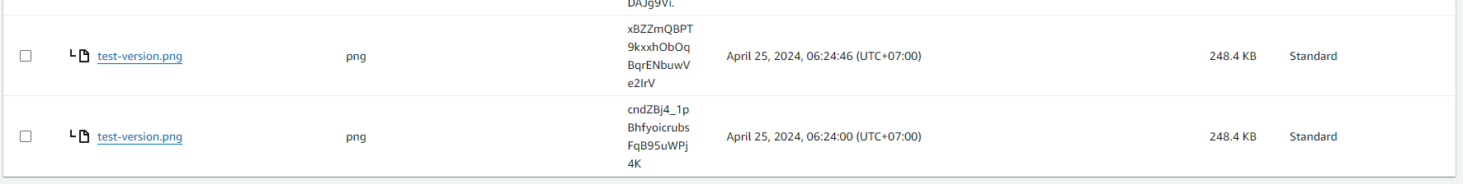
(4) Upload file same file name after versioning

Slide 6
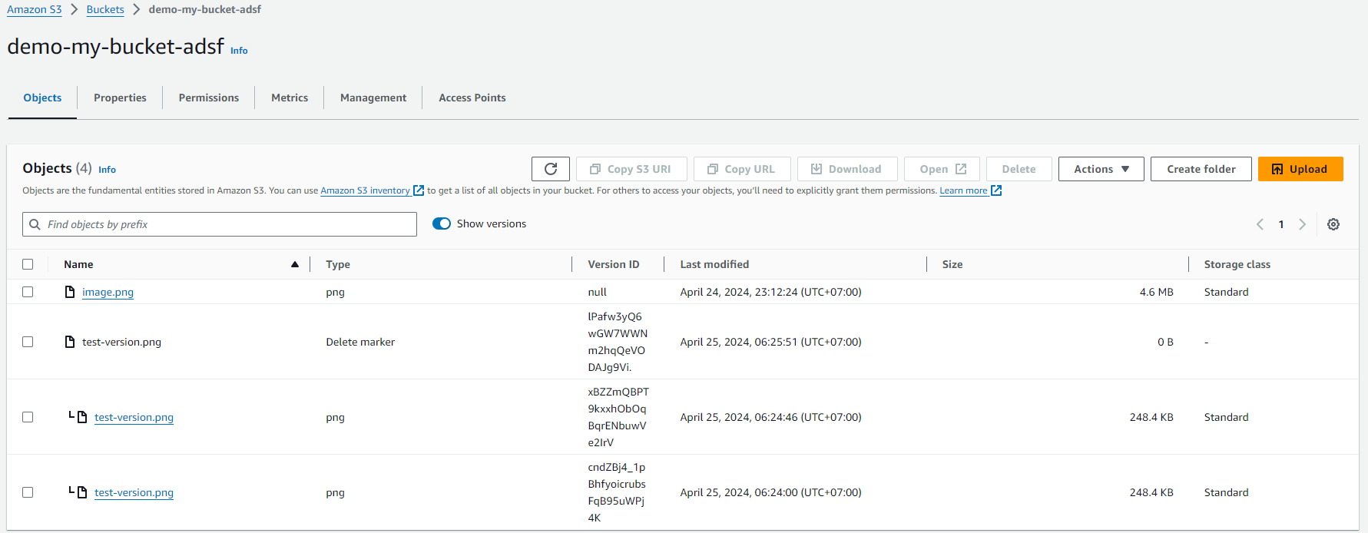
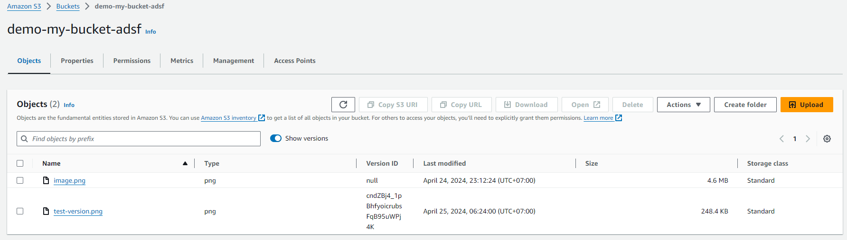
(5) Delete file after versioning

Slide 7
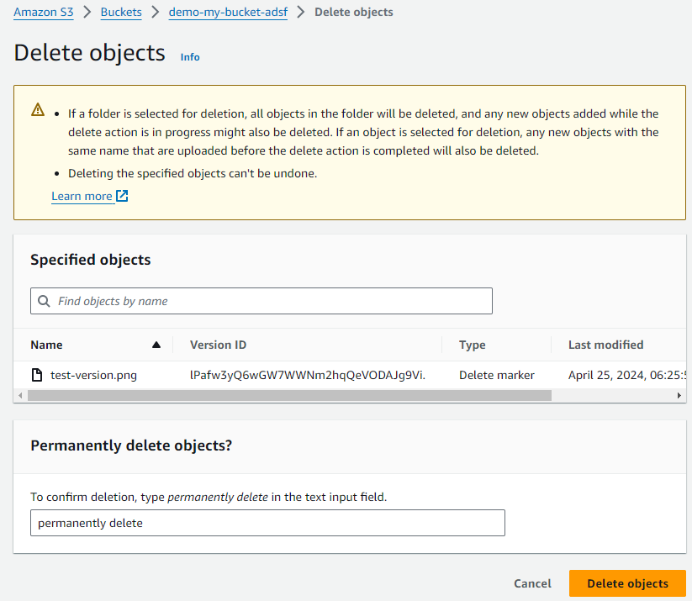
(6) Restore file

Slide 8
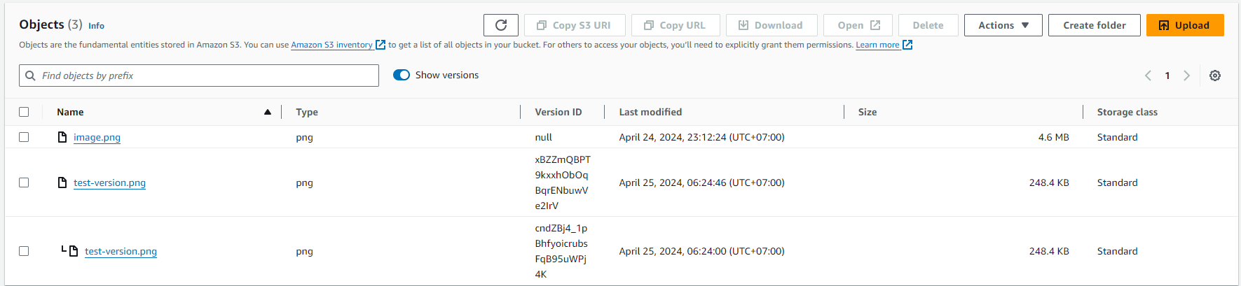
(6) Restore file

Slide 9
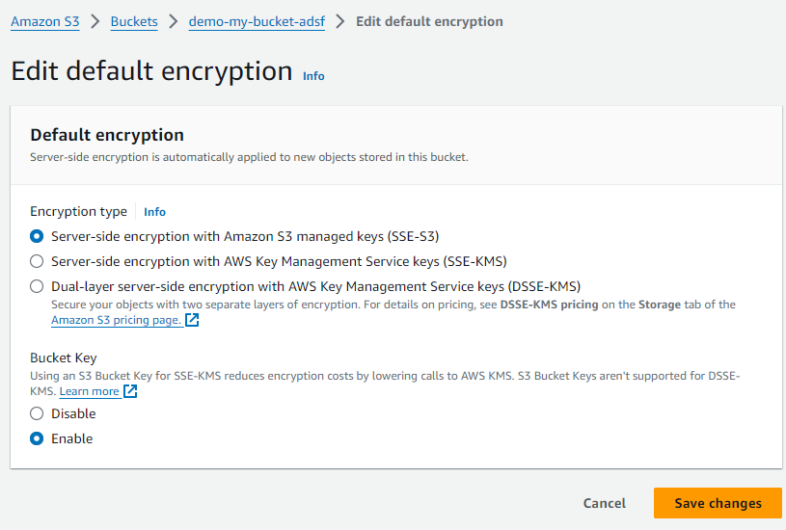
(7) Enable SSE-S3 enncription

Slide 10
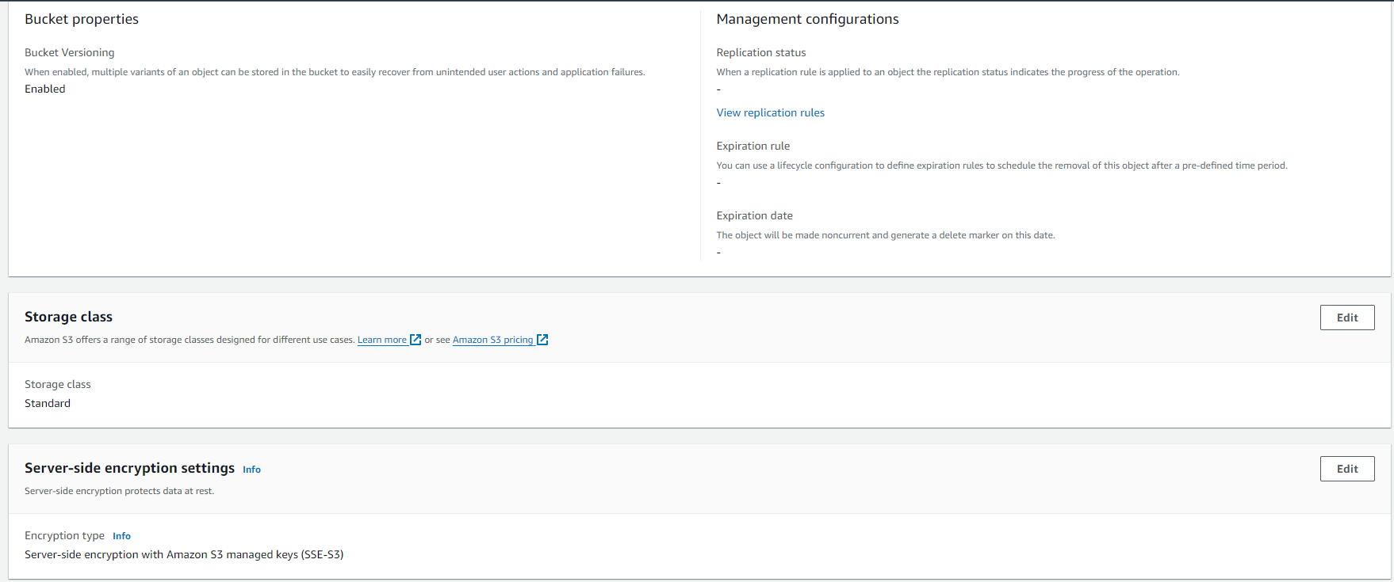
(7) Upload file & check property

Slide 11
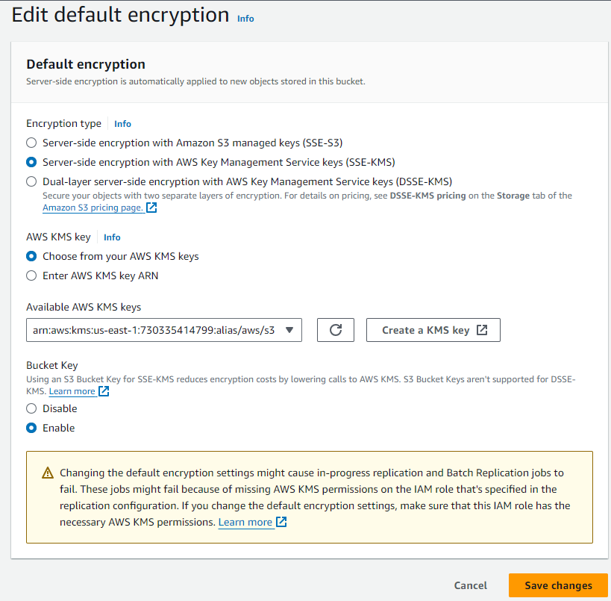
(8) Enable SSE-KMS aws/s3 enncription

Slide 12
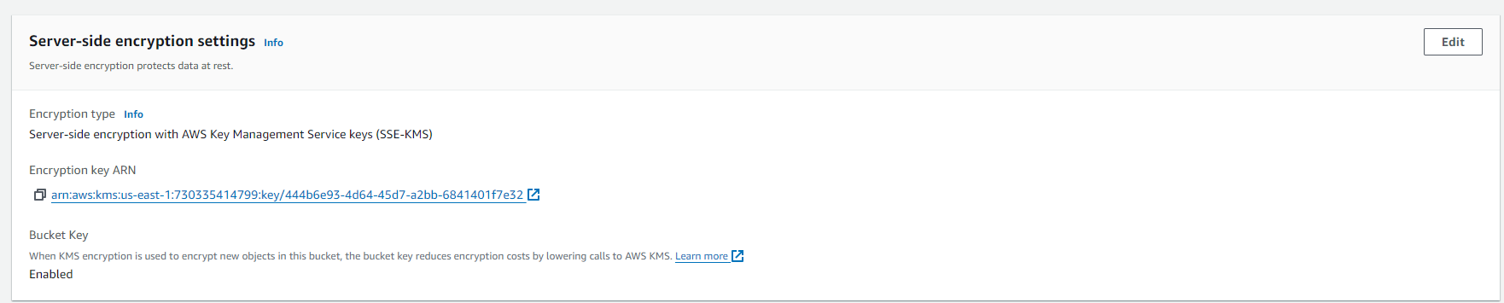
(8) Upload file & check property

Slide 13
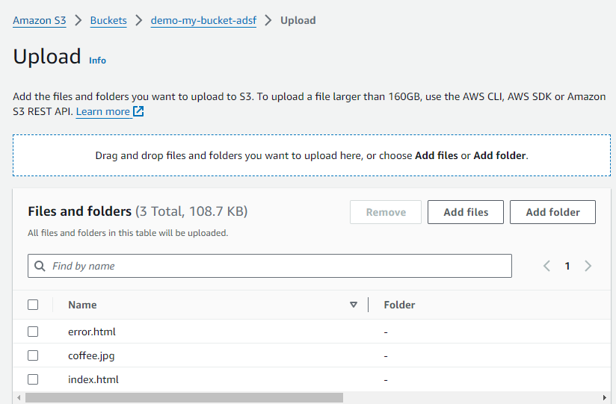
(9) Host website - upload

Slide 14
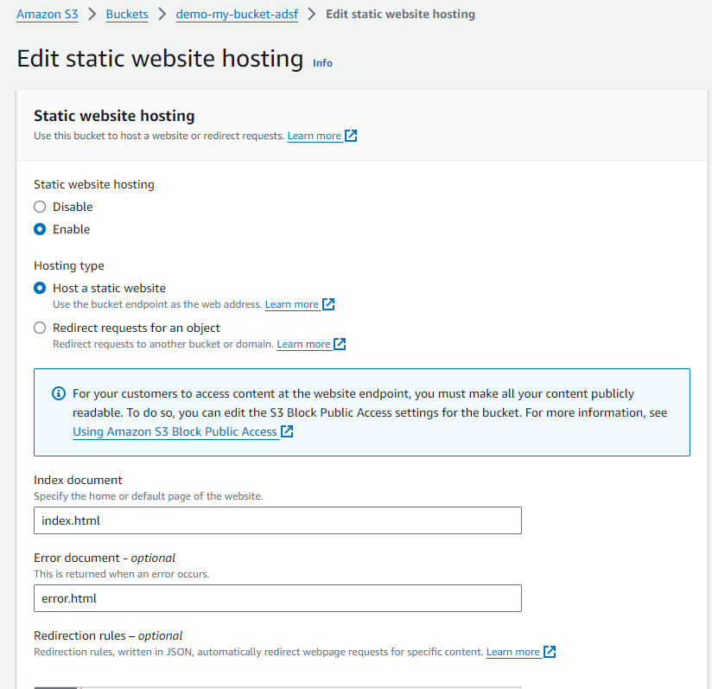
(9) Host website – enable static web hosting

Slide 15
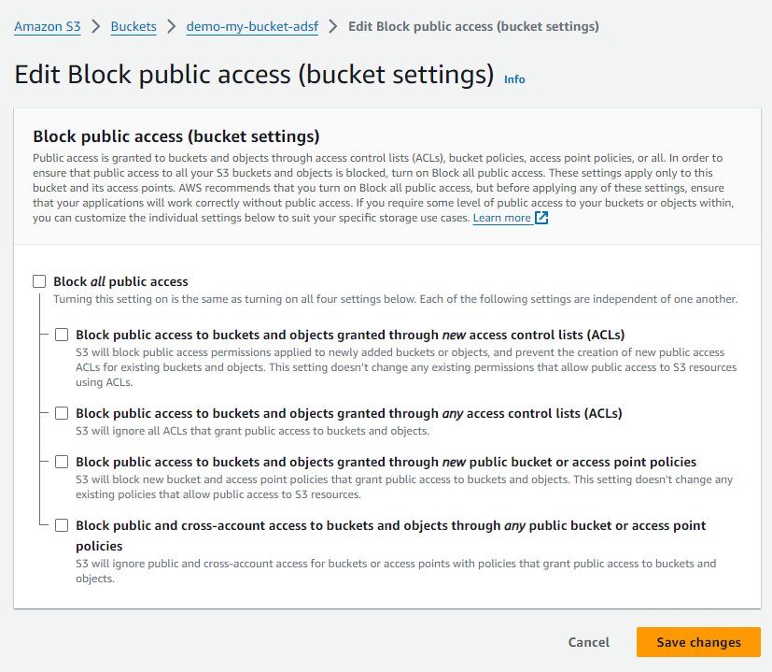
(9) Host website – edit bucket policy

Slide 16
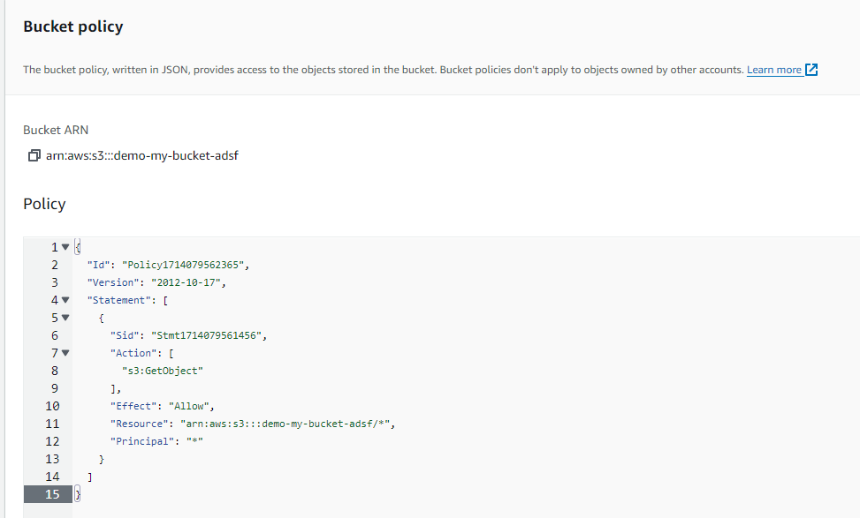
(9) Host website – edit bucket policy

Slide 17
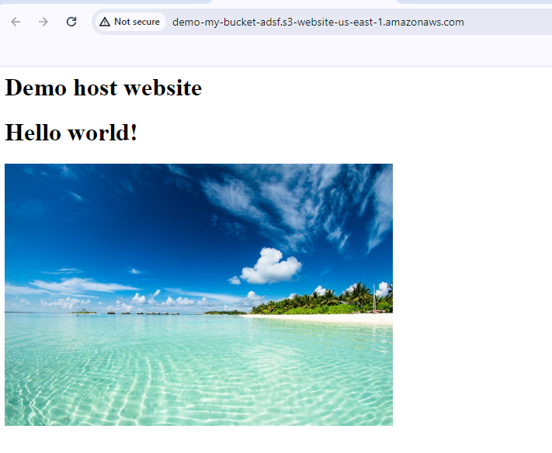
(9) Host website – check website

Slide 18
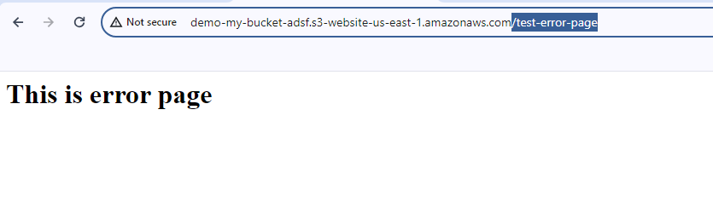
(9) Host website – check website

Slide 19
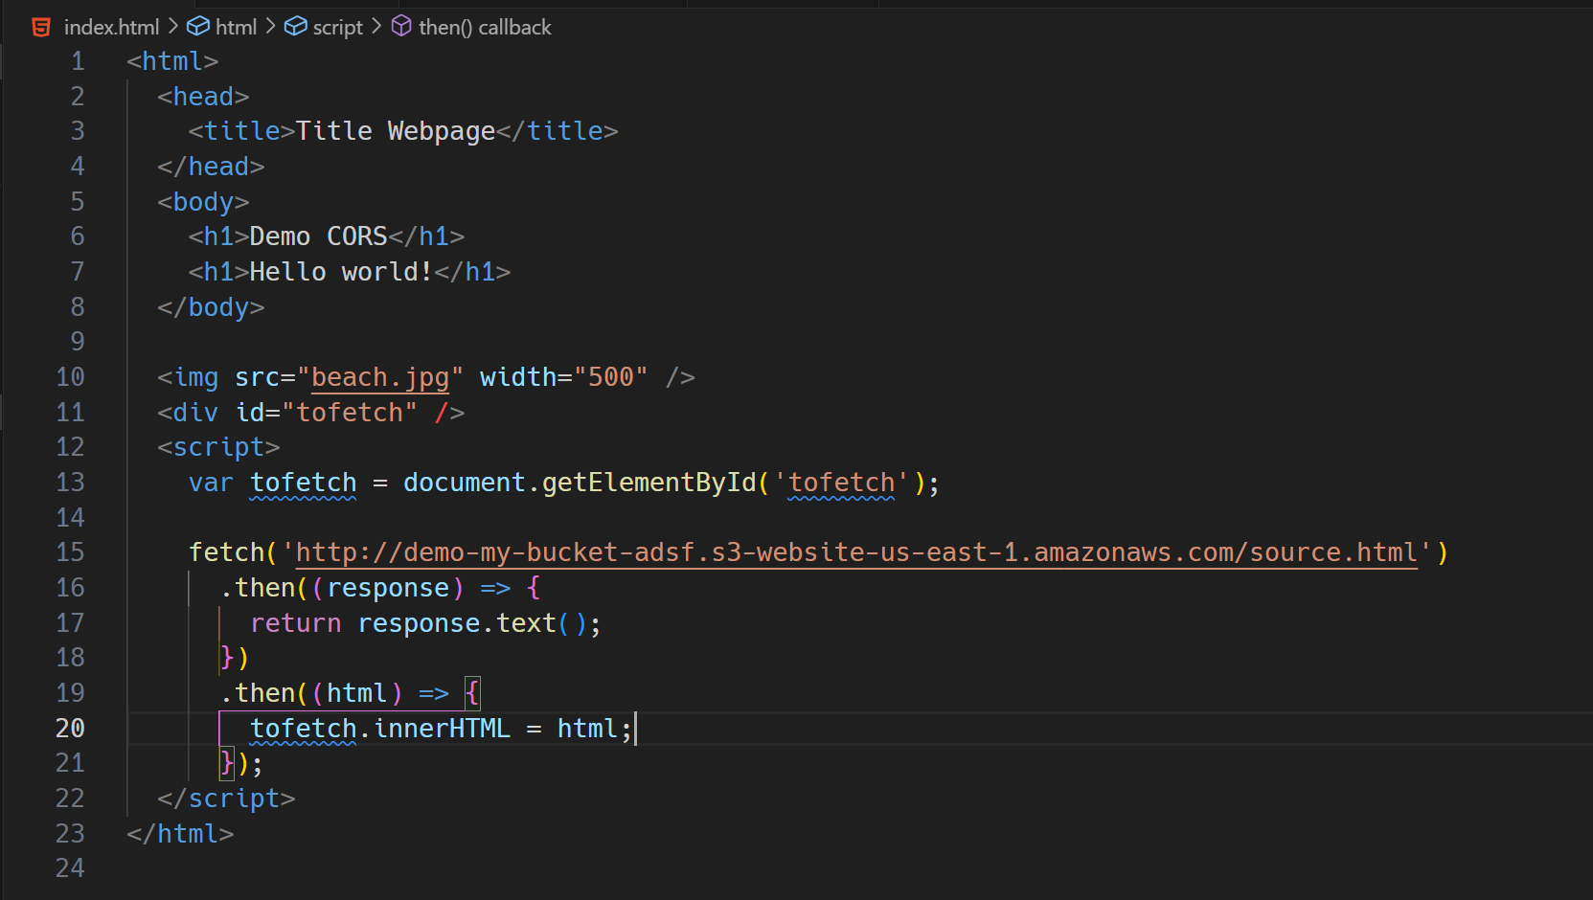
(10) CORS same origin – index.html content

Slide 20
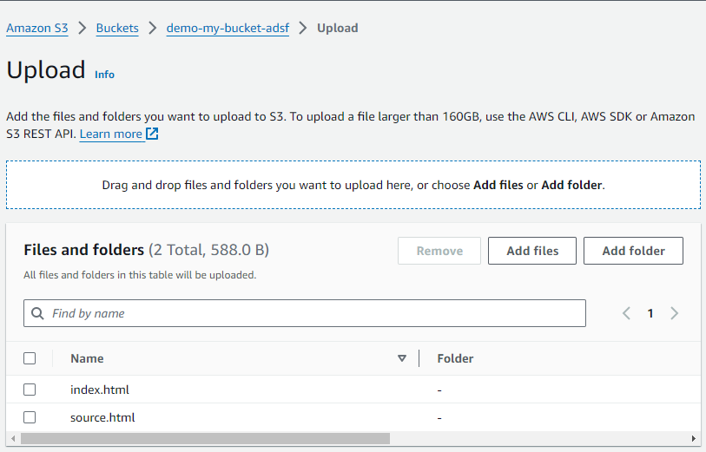
(10) CORS same origin– upload file

Slide 21
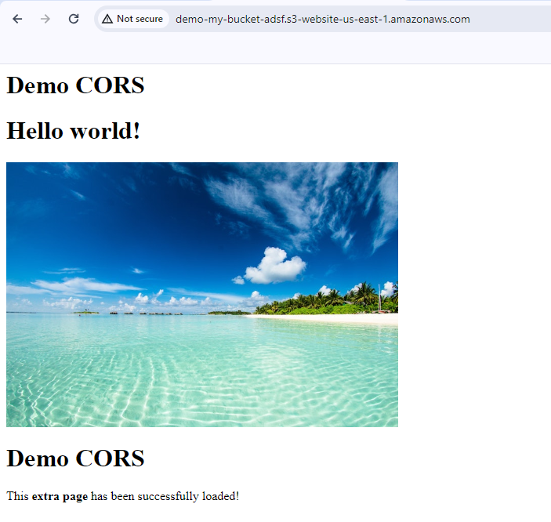
(10) CORS same origin– check website

Slide 22
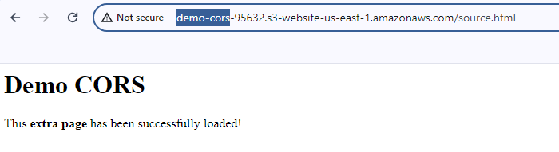
(10) CORS different origin– create new bucket and enable host static website

Slide 23
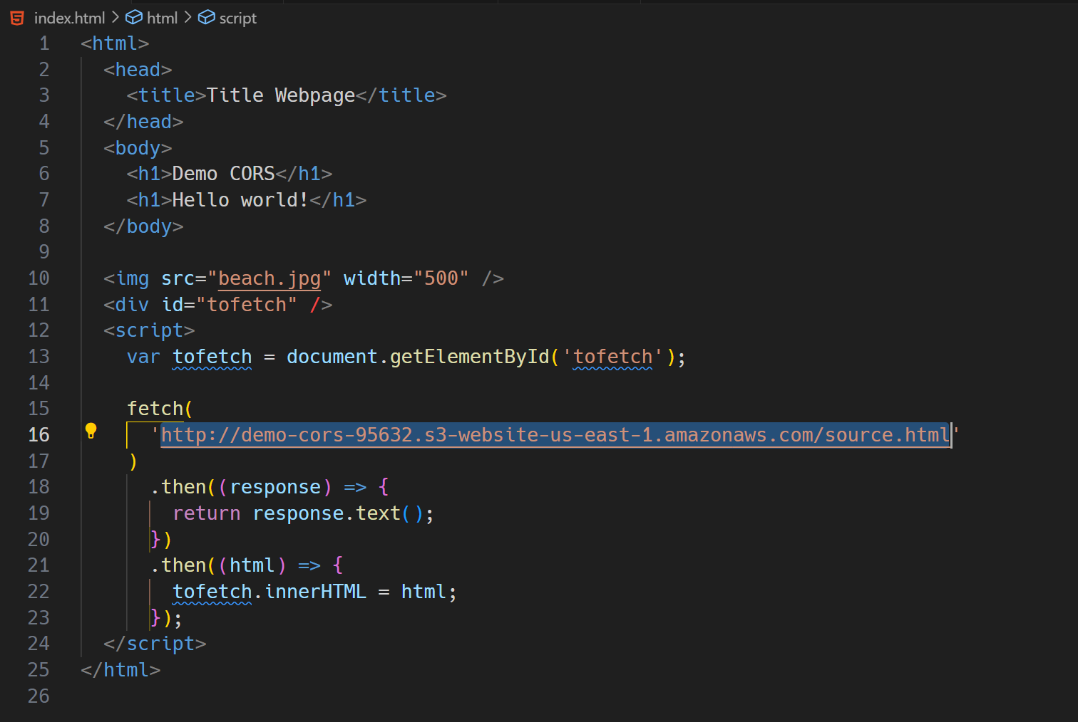
(10) CORS different origin– edit/upload index.html to fetch http://demo-cors-95632....com/

Slide 24
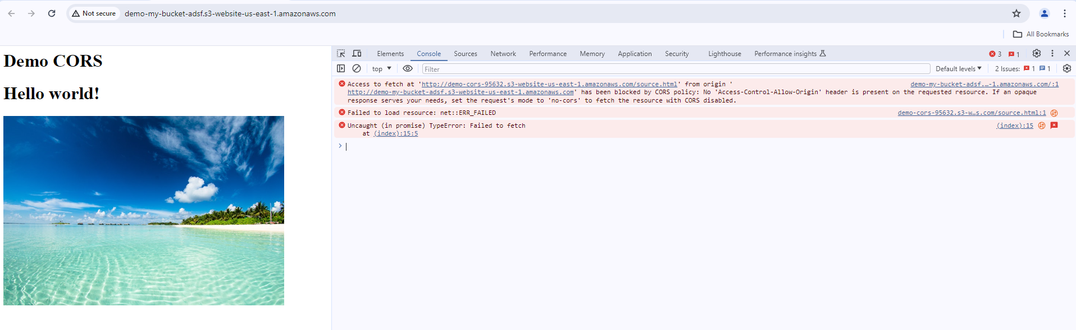
(10) CORS different origin– check error

Slide 25
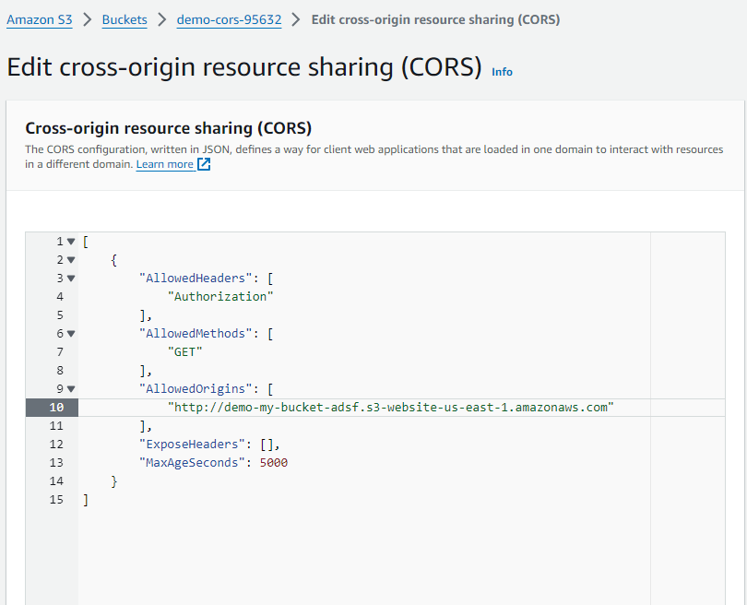
(10) CORS different origin– edit cors

Slide 26
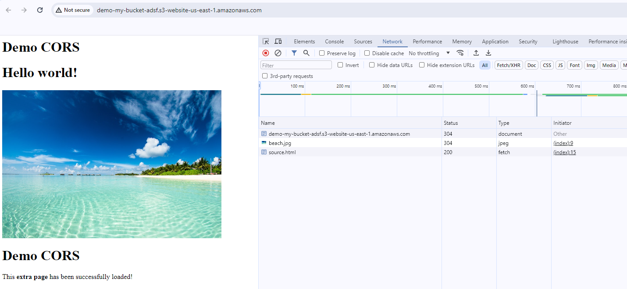
(10) CORS different origin– check website

Slide 27
(11) Clean up

Slide 28
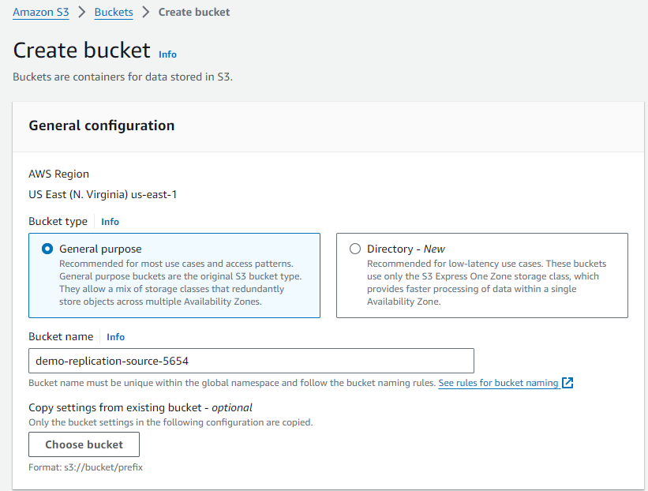
(12) Replication – create source bucket

Slide 29
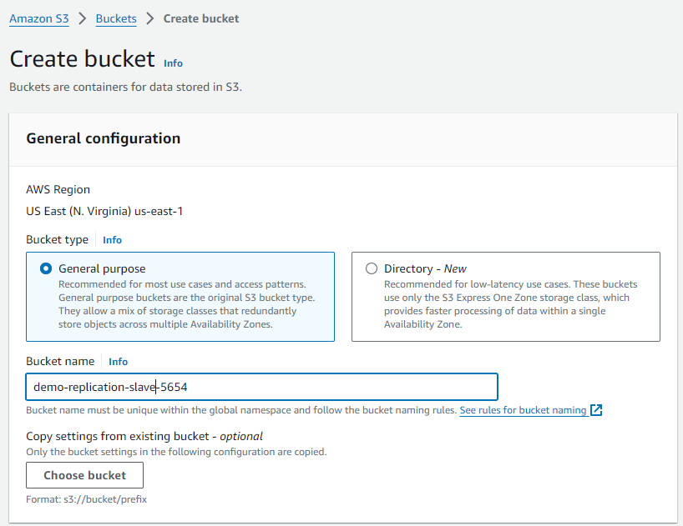
(12) Replication – create slave bucket

Slide 30
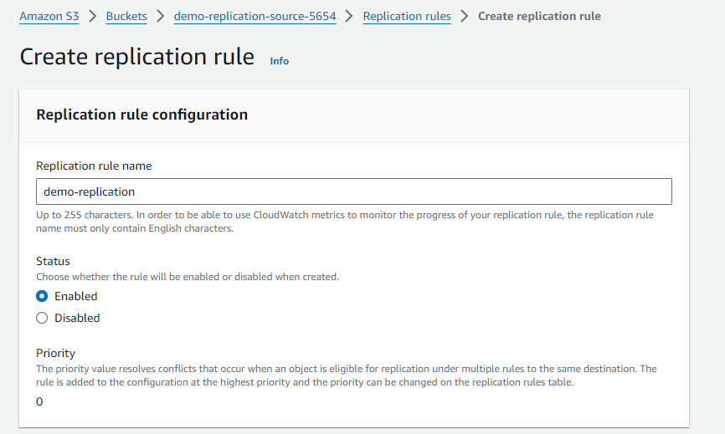
(12) Replication – Create replication rule

Slide 31
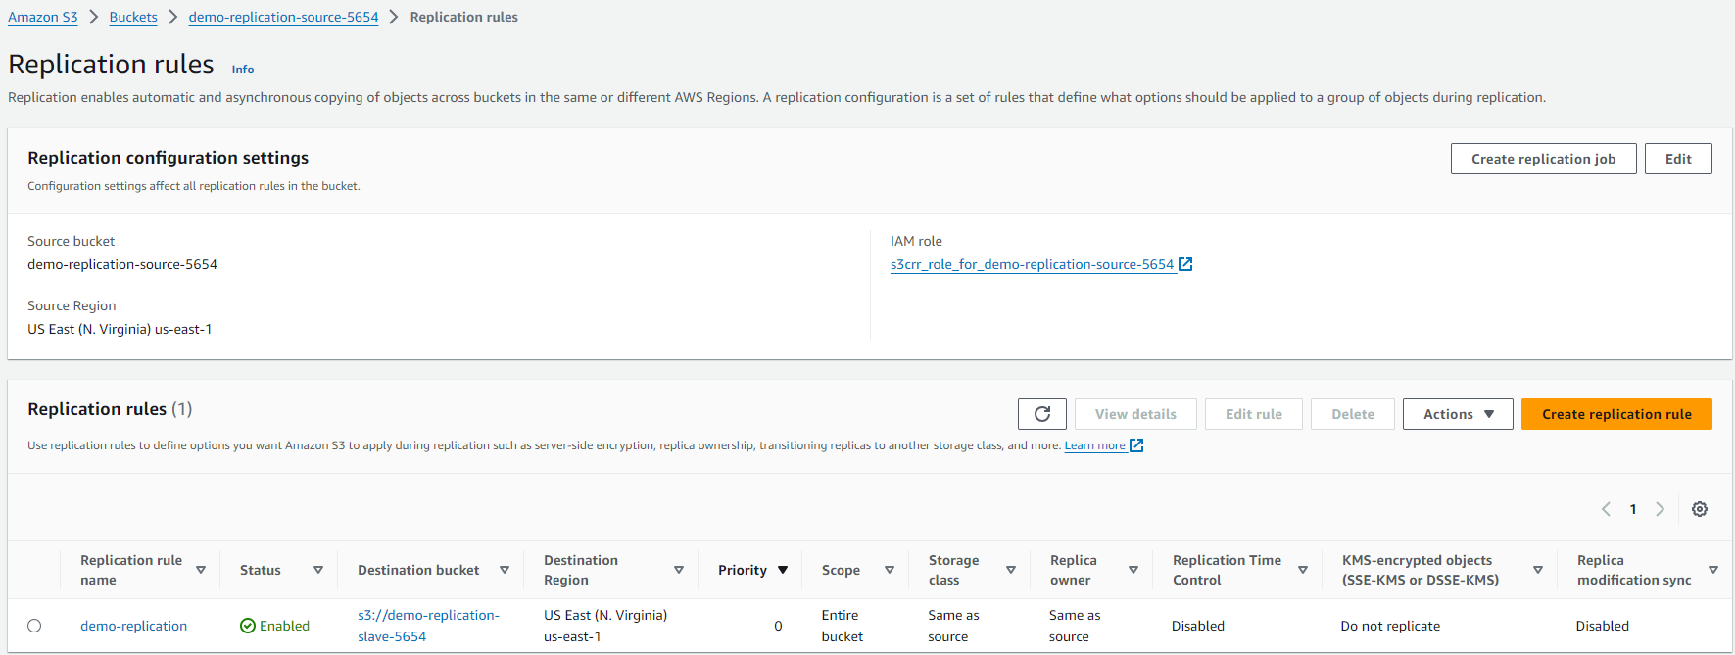
(12) Replication – Create replication rule

Slide 32
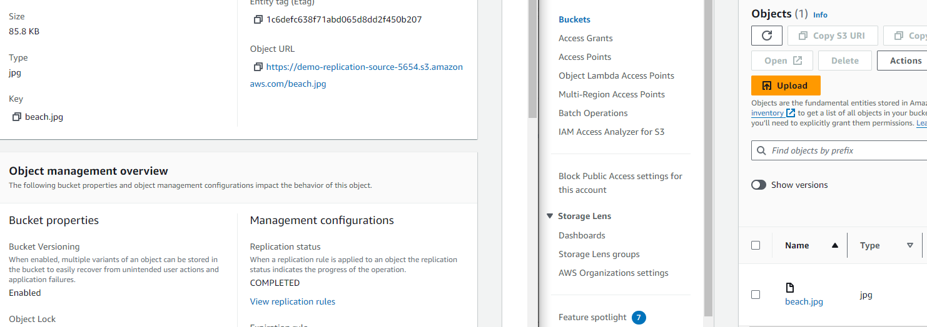
(12) Replication – Check replication

